Slide 1
DATA 201:
Group 5 Project Mid-presentation
Ishaan Shetty
Naman Sudan
River Roseveare-Hunt

Slide 2
Project roadmap
Group 5
Phase 1
Phase 2
Phase 3
Phase 4
Phase 5
DATA SET SELECTION
ANALYSIS AND UNDERSTANDING
NORMALIZATION
DATABASE SETUP AND ETL
BUSINESS QUESTIONS
The what and the why
Getting to know our data
Prepping the dataset for loading
Setting up PostgreSQL DB and Extract, Transform, and Load
What can we learn from this dataset?

Slide 3
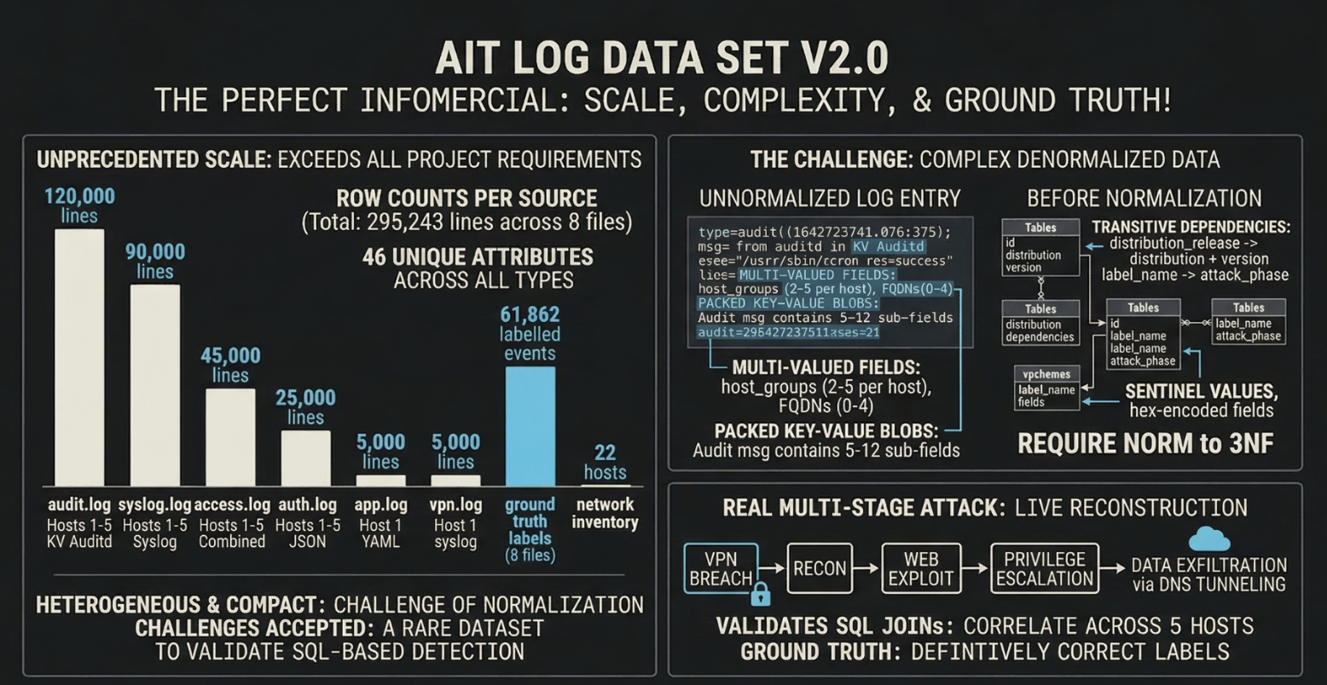
Phase 1: Dataset Selection & Motivation
What it is:
Simulated enterprise network (22 hosts) over 4 days (Jan 21-25, 2022).
A real multi-stage cyberattack: VPN breach → recon → web exploit → privilege escalation → data exfiltration via DNS tunneling.
Ground truth labels: 61,862 labeled attack events across 8 log files (labels are definitely correct)
Why we chose it:
Publicly available cybersecurity data with labeled ground truth is rare.
Inherently denormalized: 7 log formats (YAML, key-value auditd, JSONL, syslog, JSON, combined log format), requiring normalization to 3NF.
Tests the core question: Can relational databases and SQL detect and reconstruct a cyberattack from distributed security logs?
Scale:
295,243 raw log lines across 8 source files on 5 hosts
61,862 ground truth attack labels (22 label types, 7 attack phases)
46 unique attributes across all log types
22 hosts in the network inventory

Slide 4

Phase 2:
Analysis and Understanding
Group 5
All files were .log or .yaml
No built in row separation
Some contained labelled attributes
Narrowed down scope to 10 files - dns, vpn, apache, audit, labels
Jupyter Notebooks for a comprehension pass on each file
22 - Attack label types

Slide 5
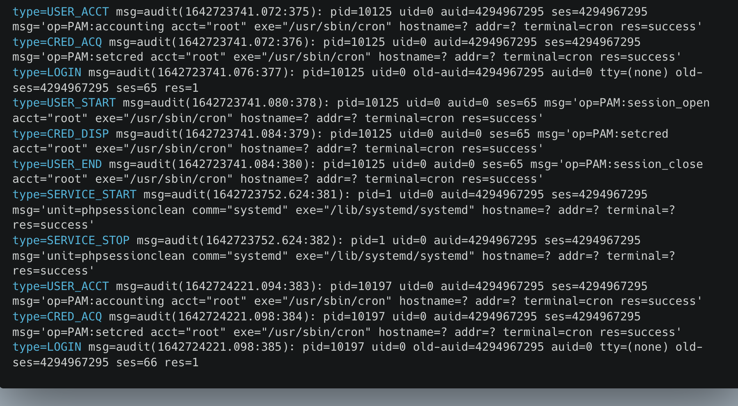
Audit Log File

Slide 6

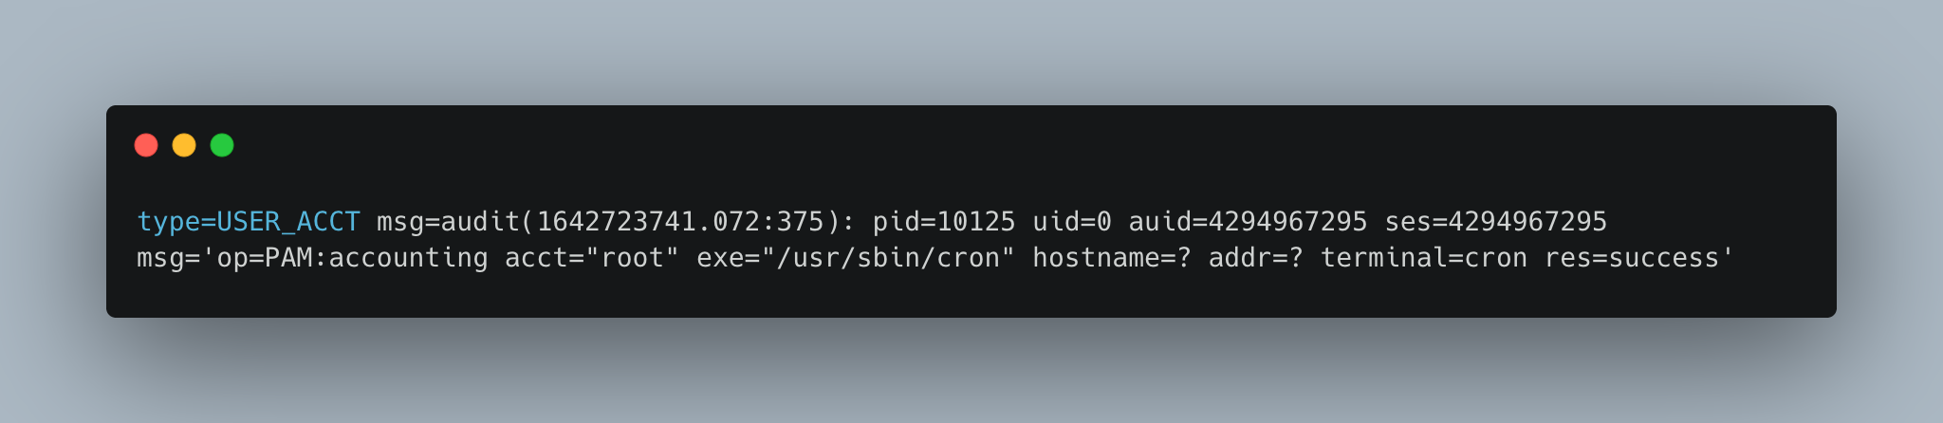
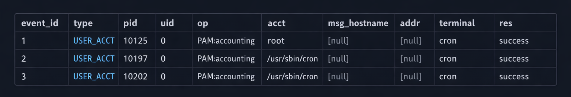
Phase 3:
Data set normalization
Group 5
We attempted independent normalization
Most tables had 1NF violations, with attributes containing values.
Some files contained nested 1NF violations
No 2NF violations - only one composite key
Many instances of functional dependencies

Slide 7
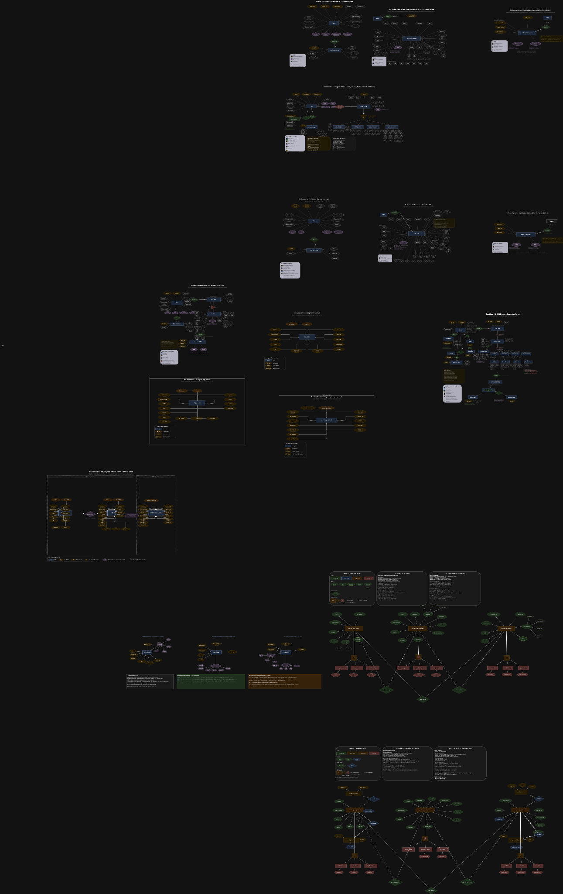
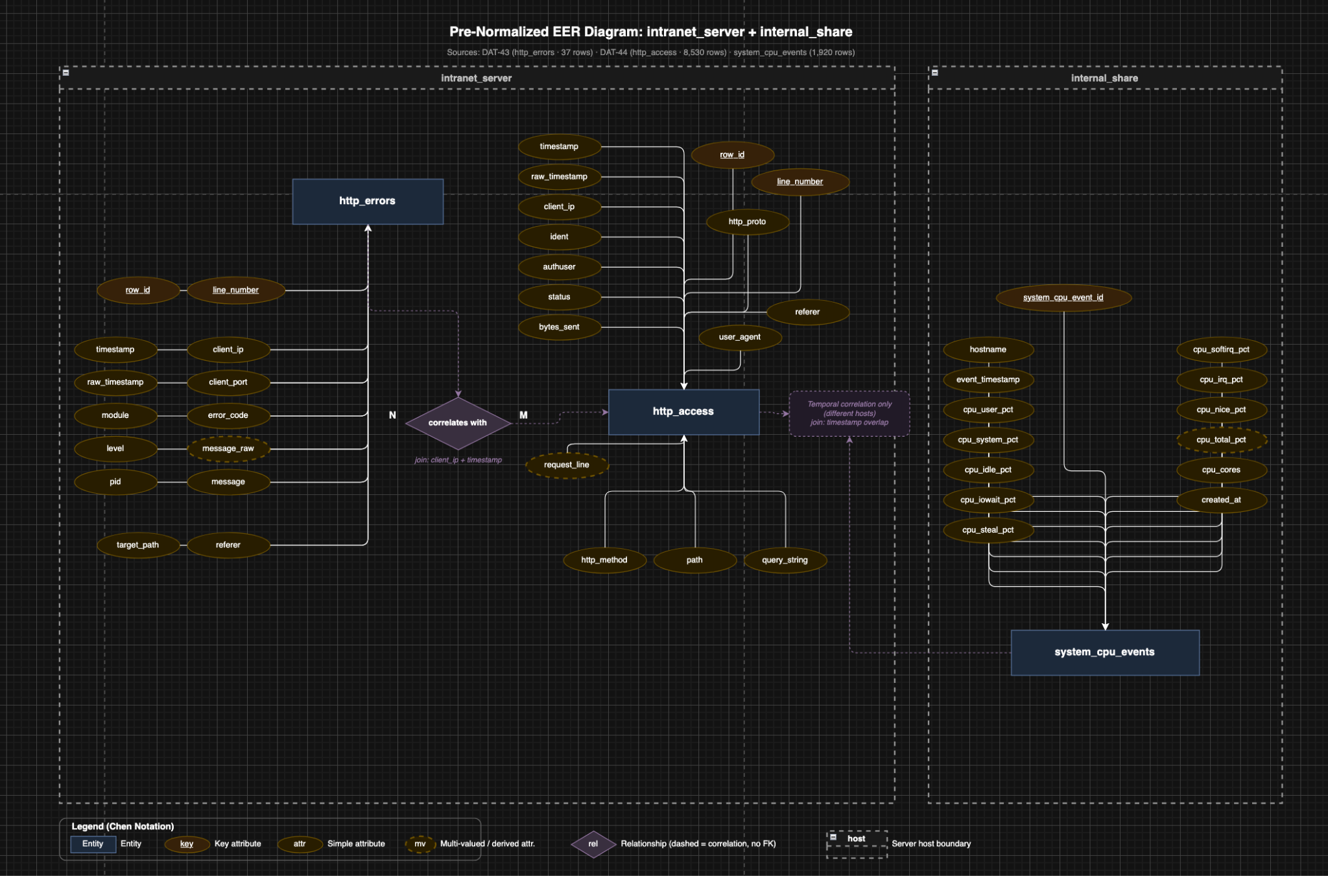
EER Diagram - First Attempts

Slide 8
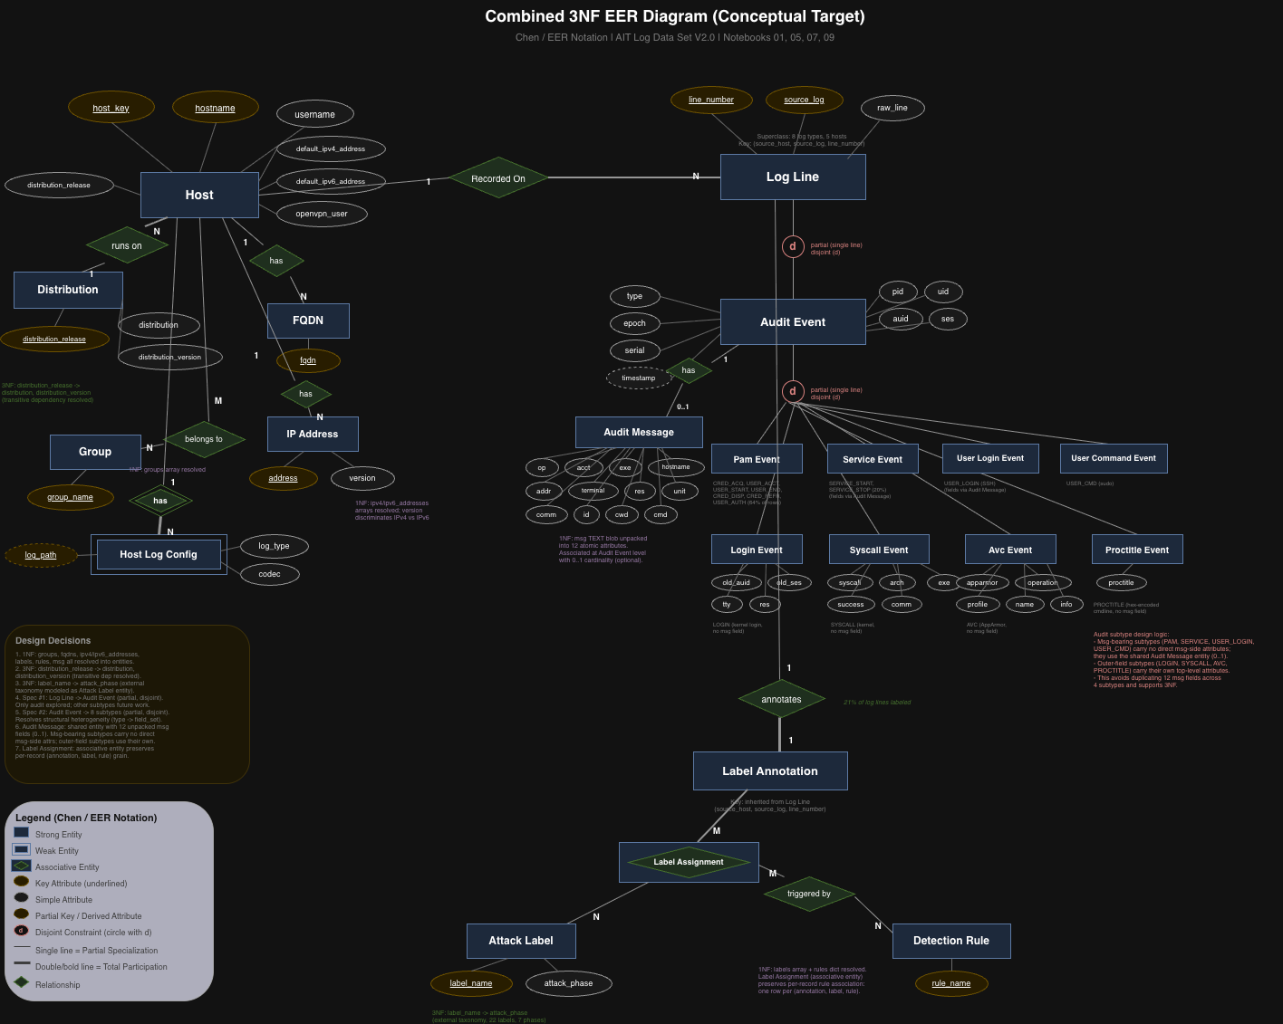
EER Diagram - Simplified Target 3NF
Significantly reduced scope
Derived from:
Hosts (Servers)
Intranet Audit Logs
Internal Share Audit Logs
Labels
Resulting 20+ Tables

Slide 9
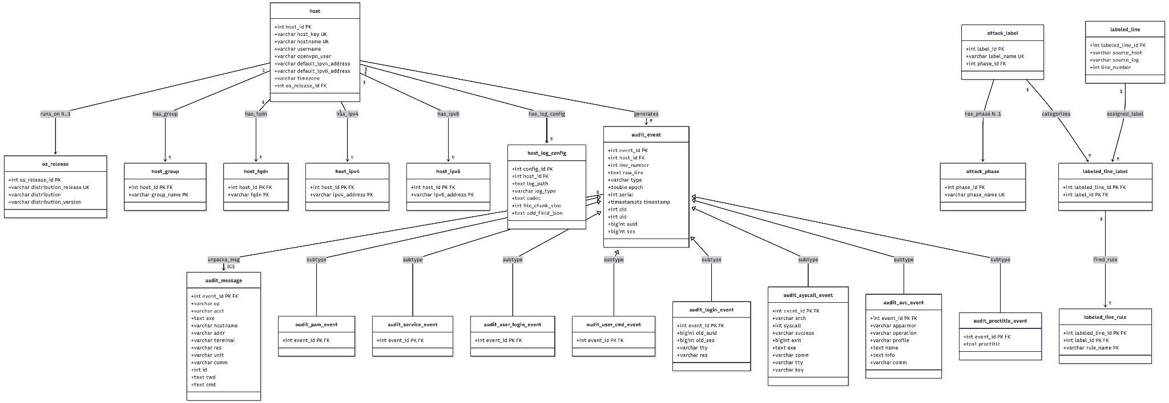
Relational Schema - Implemented

Slide 10
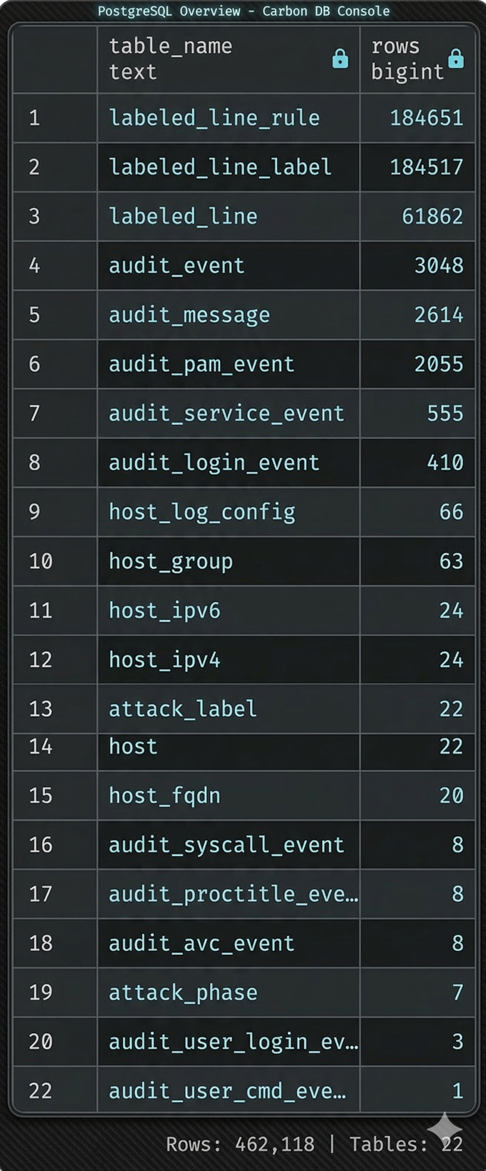
Phase 4: Database Setup & ETL
Infrastructure: PostgreSQL 16 (Docker) | Alembic migrations | pgAdmin 4
Project structure:
src/models/ SQLAlchemy ORM models (staging + final 3NF)
src/parsers/ Parse raw files into structured dicts
src/loaders/ Load parsed data into PostgreSQL tables
alembic/ Versioned migration scripts for schema changes
ETL pipeline (ran twice):
Raw files → staging tables (source-faithful, 1NF violations preserved)
Staging tables -> final 3NF tables (normalization applied)
22 normalized tables loaded: 439,000+ rows

Slide 11

Phase 5:
Business Questions
Group 5

Slide 12
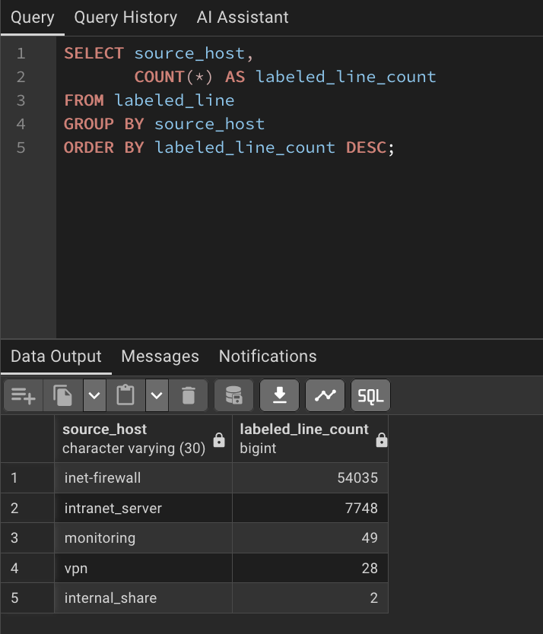
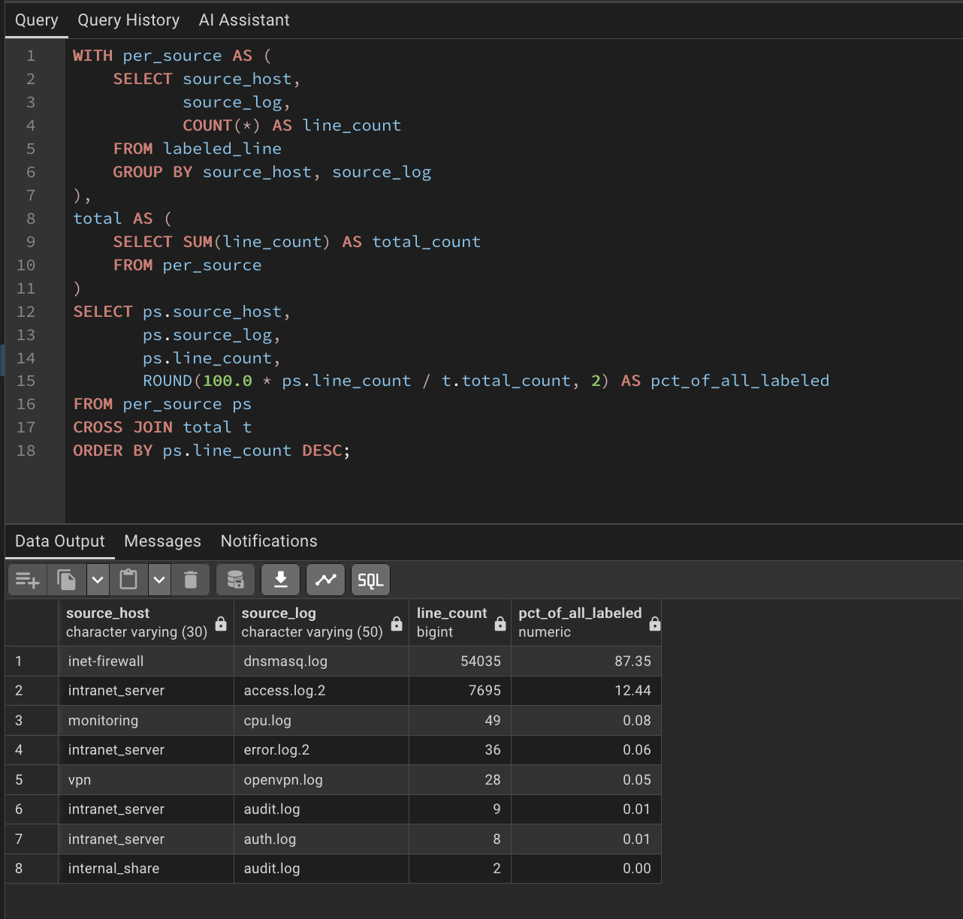
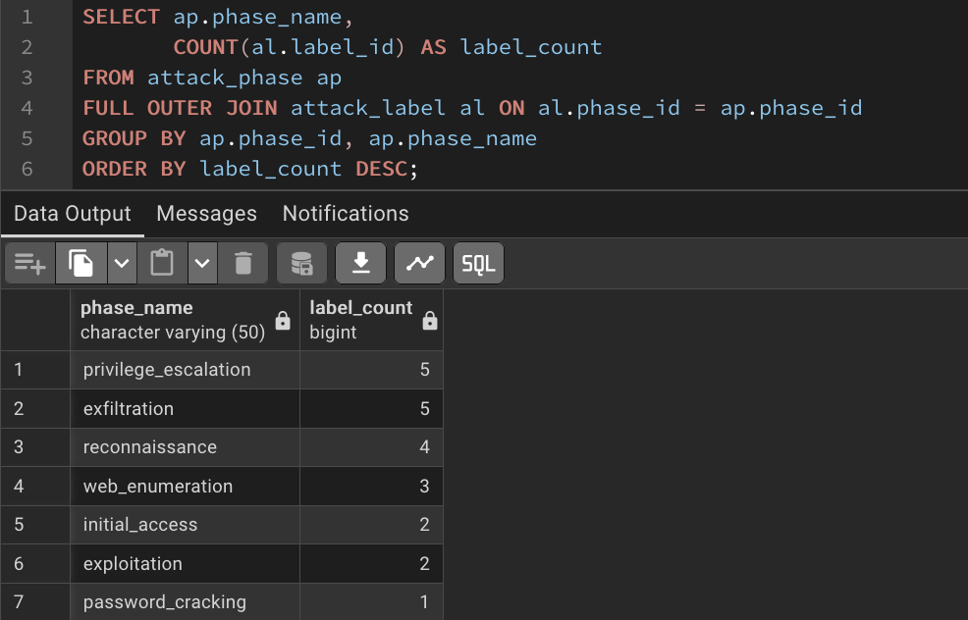
River’s Business Questions
Group 5
Question 1
Question 2
Question 3
How many labels types are there in each attack phase?
How many labeled lines does each source host have?
How is labeling and souce host related to source log files?
Results 1
Results 2
Results 3

Slide 13
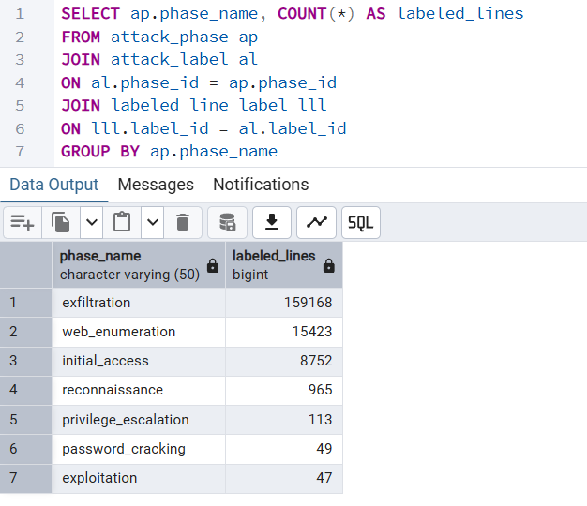
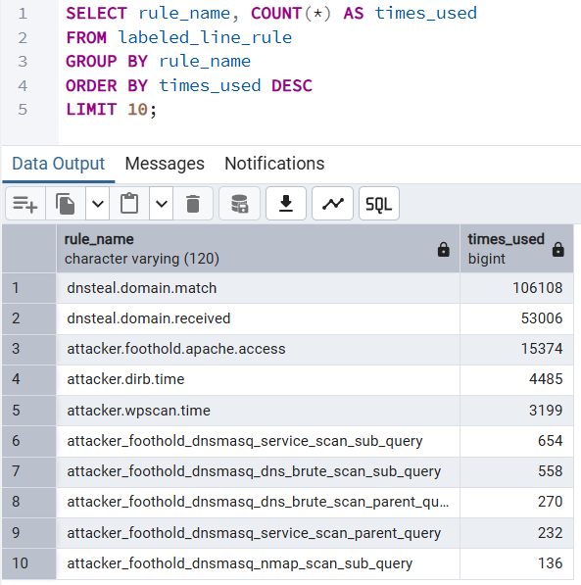
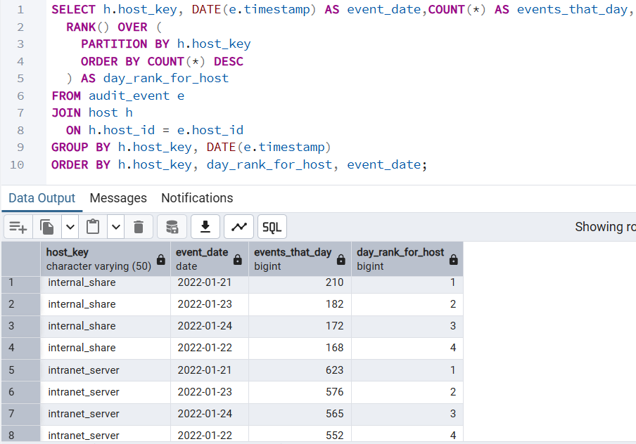
Ishaan’s Business Questions
Group 5
Question 1
Question 2
Question 3
How many events does each host generate per day, and which days are that host’s busiest?
How many labeled lines do we have per attack phase?
What are the top 10 most used labeling rules?
Results 1
Results 2
Results 3
Brief description

Slide 14
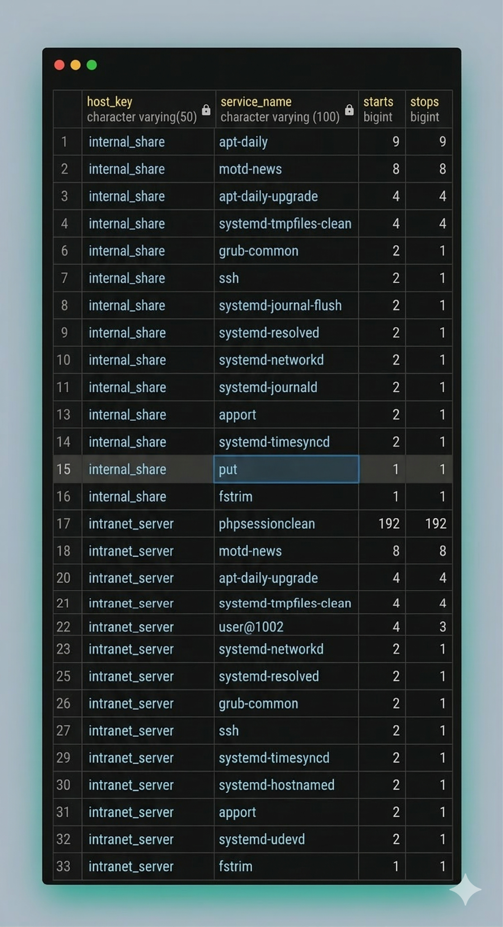
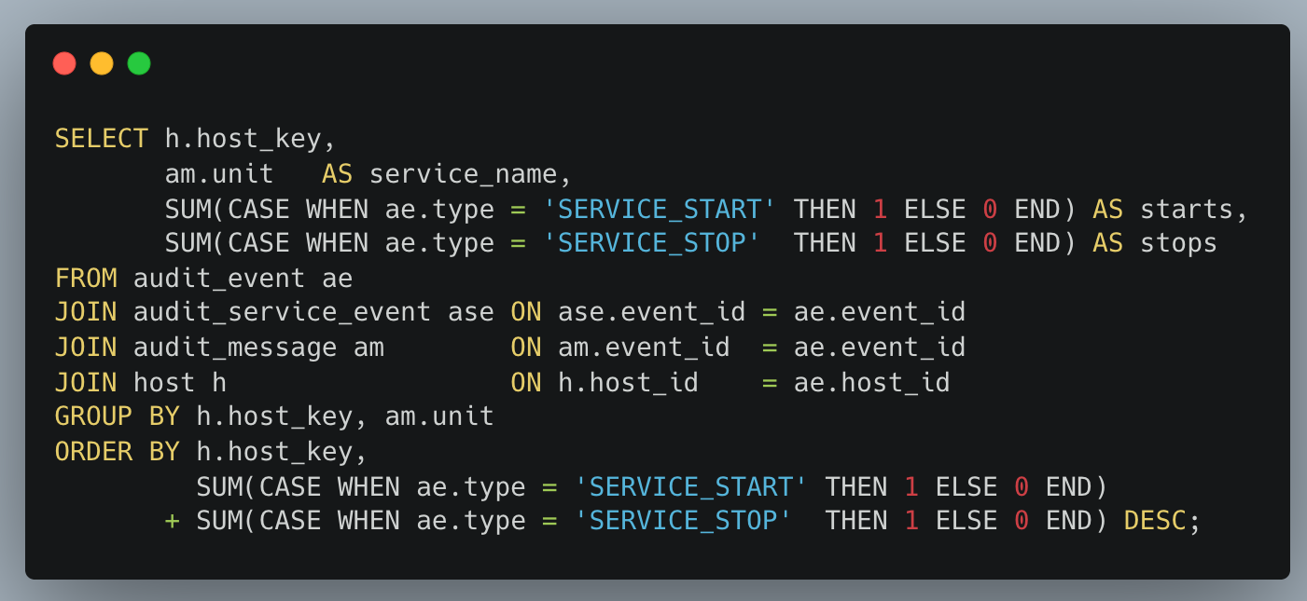
Naman’s Business Questions
What is the baseline service activity on monitored hosts?
Finding
"put" service on internal_share: 1 start, 1 stop amid hundreds of routine services. Anomalous.

Slide 15
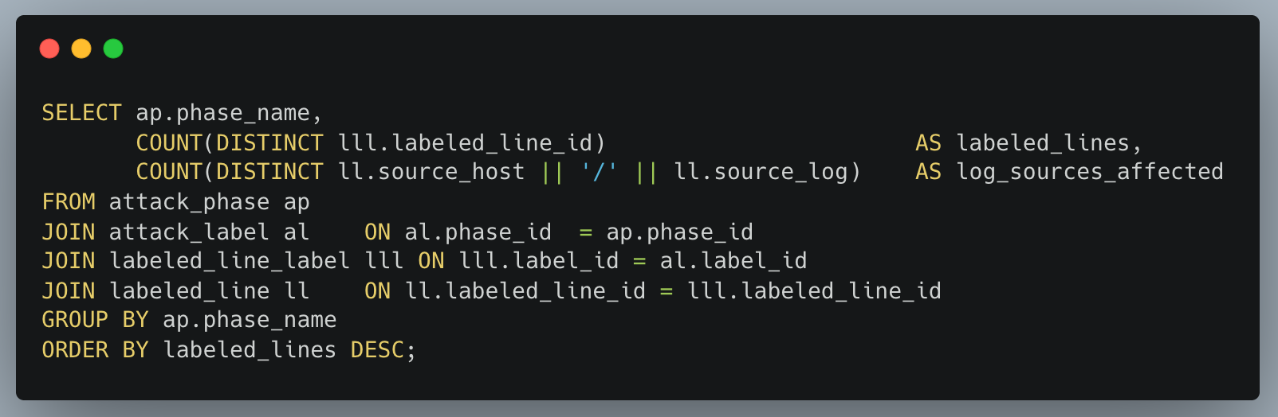
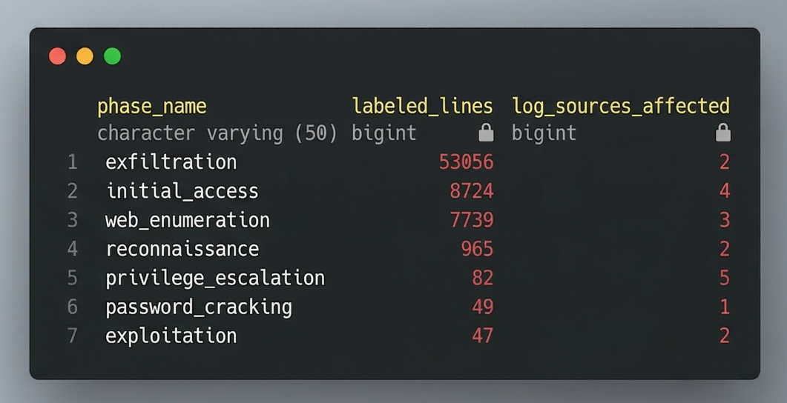
Naman’s Business Questions
Where does the attack leave the most evidence, and which phases are hardest to detect?
Finding
Exfiltration: 53K lines in 2 sources. Privilege escalation: only 82 lines but across 5 sources. The most critical phase is the quietest. The silent killer.

Slide 16
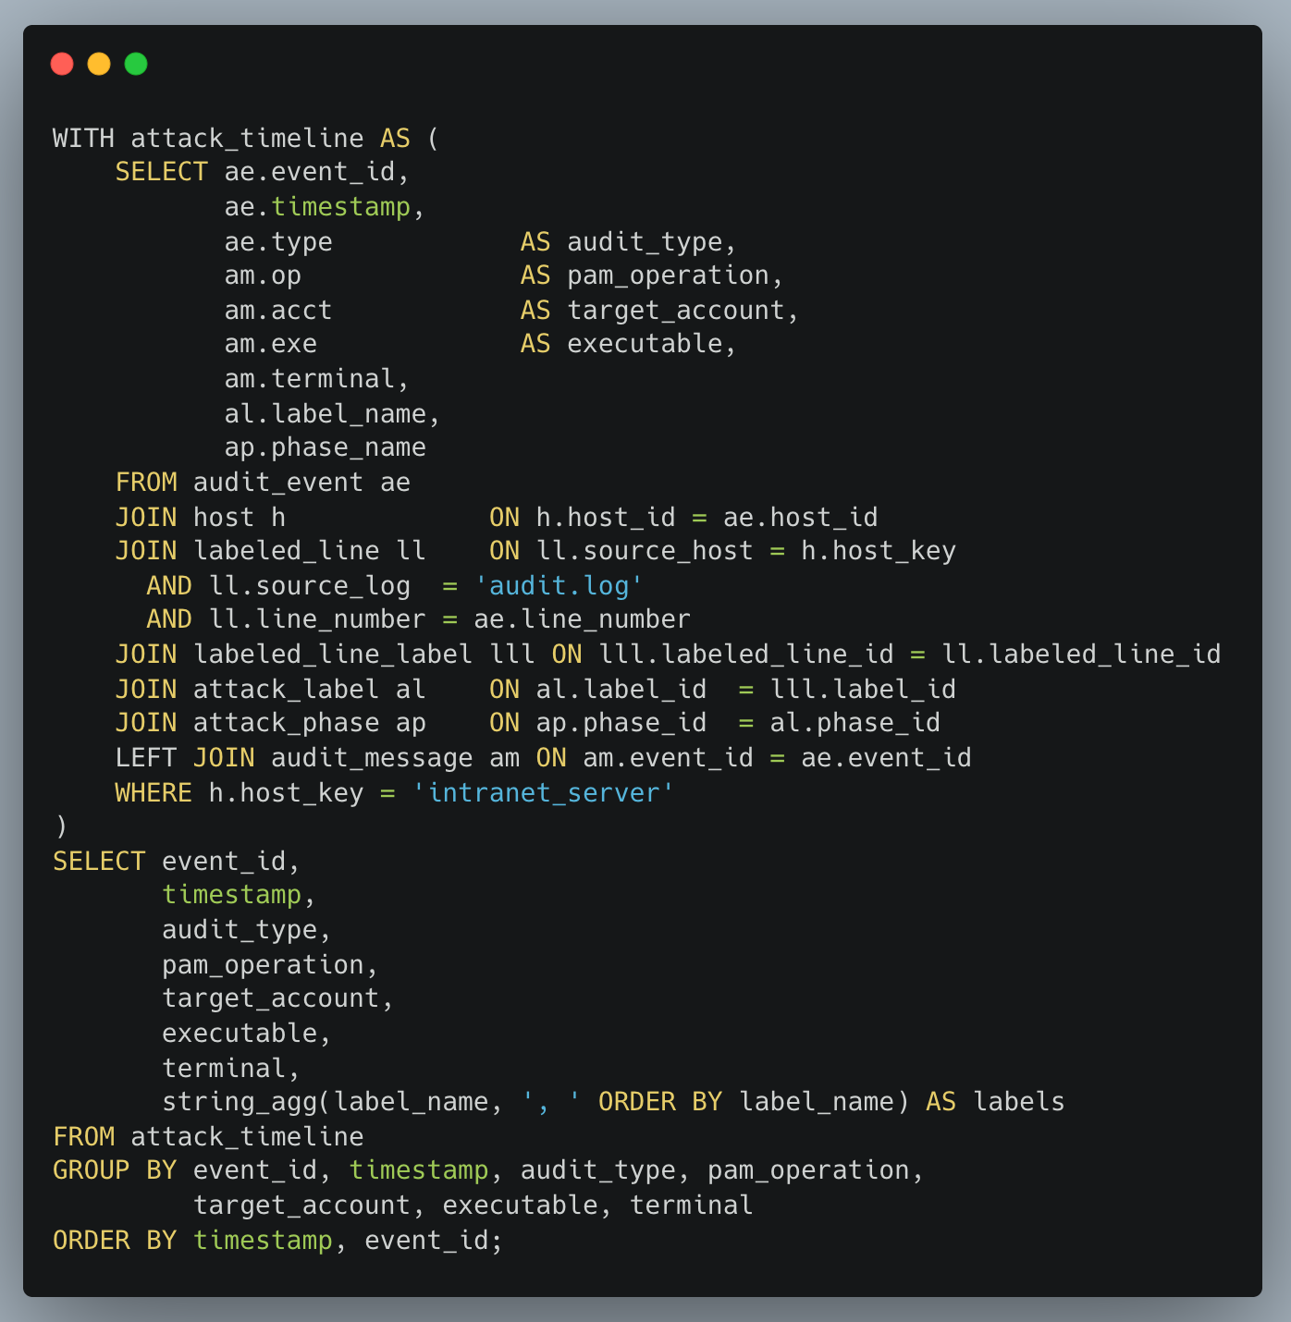
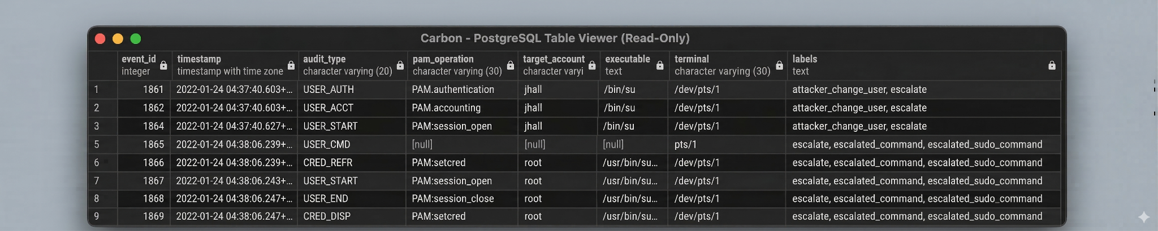
Naman’s Business Questions
Can we reconstruct the exact privilege escalation attack sequence?
Finding

Slide 17

Challenges and Next Steps
Group 5
Challenges
Massive, highly technical dataset
Inconsistent formatting
Heavy time investment
Complex data transformation and integration
Next Steps
Expand data scope
Construct attack timeline
Visualize insights
Deliver technical report

Slide 18





Project Management Tools
Github
Version Control
Trunk-based development
Linear
Sprint planning
Task tracking
Slack
Communications
Docker
Reproducible PostgreSQL environment
Alembic
Database migration management
Group 5
Github Repo

Slide 19
Questions?

Slide 20
Thank you
Group 5

